Slide 1

Chapter 7 Part 1
Introduction to Structured Query Language (SQL)
The slides in this presentation have been adapted from slides provided with the textbook, Database Systems: Design, Implementation, and Management,
12E, Cornel and Morris, Copyright © 2017 Cengage Learning.

Slide 2
Learning Objectives
Explain the basic commands and functions of SQL
Use SQL for data definition (to create tables and indexes)
Use SQL for data manipulation (to add, modify, delete, and retrieve data)
Create and query a database using SQL
Copyright © 2017 Cengage Learning
2

Slide 3
Structured Query Language (SQL)
Categories of SQL function
Data definition language (DDL)
Data manipulation language (DML)
Nonprocedural language with basic command vocabulary set of less than 100 words
Easy to learn
De facto language for Relational Databases
National and international standard since mid-1980’s
Versions of SQL (ANSI Standard, Vendor Add-On’s, etc)
Compatible with all major DBMS systems (IBM’s DB2, Oracle DBMS, MySQL, MS SQL Server, and MS Access)
Copyright © 2017 Cengage Learning
3

Slide 4
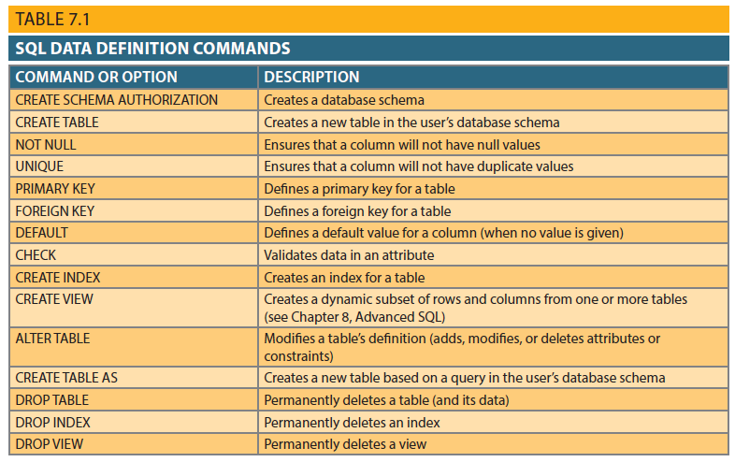
SQL Data Definition Language (DDL) Commands
Copyright © 2017 Cengage Learning
4

Slide 5
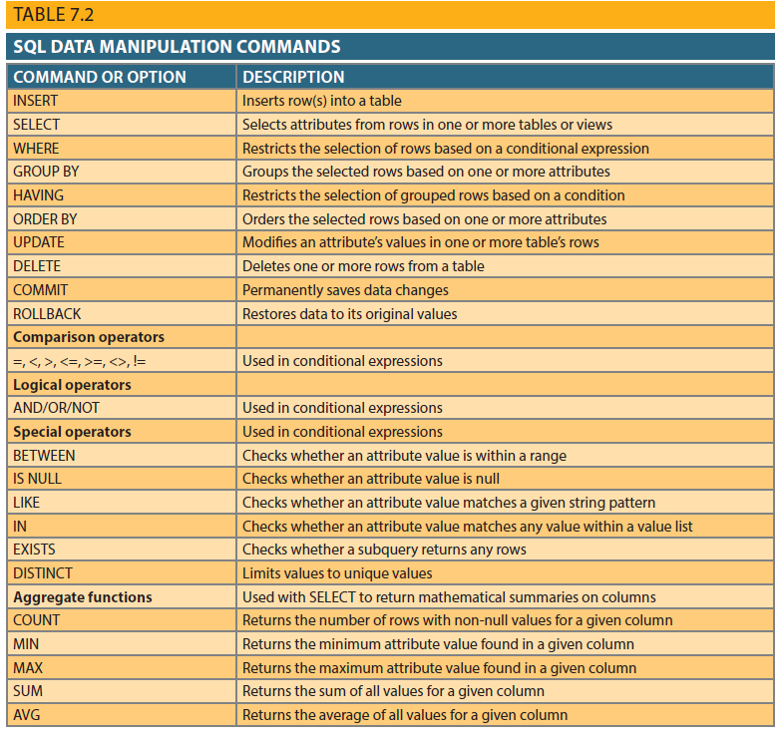
SQL Data Manipulation Language (DML) Commands
Copyright © 2017 Cengage Learning
5

Slide 6
Create Table Statement for Invoice
CREATE TABLE INVOICE (
inv_number number(10) not null,
inv_cus_code number (10) not null,
inv_date date,
CONSTRAINT invoice_pk PRIMARY KEY (inv_number),
CONSTRAINT fk_customer
FOREIGN KEY (inv_cus_code)
REFERENCES CUSTOMER (cus_code)
);
Copyright © 2017 Cengage Learning
6

Slide 7
Creating Table Structures
Use one line per column (attribute) definition
Use spaces to line up attribute characteristics and constraints
Table and attribute names are capitalized
NOT NULL specification
UNIQUE specification
Primary key attributes contain both a NOT NULL and a UNIQUE specification
RDBMS will automatically enforce referential integrity for foreign keys
Copyright © 2017 Cengage Learning
7

Slide 8
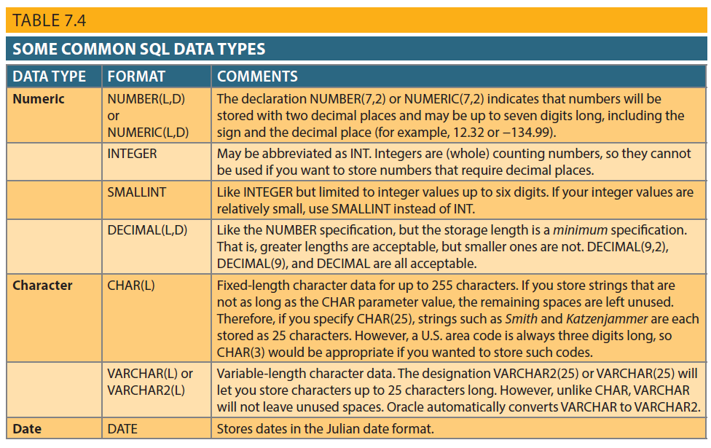
Copyright © 2017 Cengage Learning
8

Slide 9
SQL Constraints
NOT NULL constraint
Ensures that column does not accept nulls
UNIQUE constraint
Ensures that all values in column are unique
DEFAULT constraint
Assigns value to attribute when a new row is added to table
CHECK constraint
Validates data when attribute value is entered
Copyright © 2017 Cengage Learning
9

Slide 10
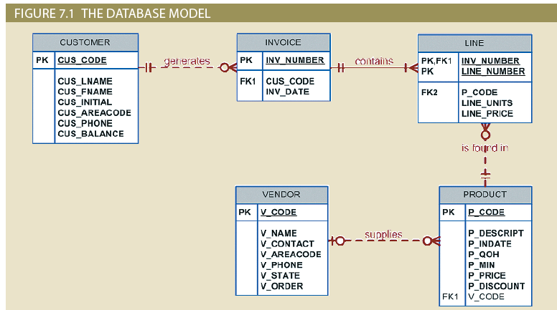
Figure 7.1 - The Database Model
Copyright © 2017 Cengage Learning
10

Slide 11
Create Table Statement for Customer
CREATE TABLE CUSTOMER (
cus_code number(10) not null,
cus_lname varchar2(25) not null,
cus_fname varchar2(25) not null,
cus_initial varchar2(1),
cus_areacode varchar2(3),
cus_phone varchar2(7),
cus_balance number (10,2),
CONSTRAINT customers_pk PRIMARY KEY (customer_code)
);
Copyright © 2017 Cengage Learning
11

Slide 12
Create Table Statement for Invoice
CREATE TABLE INVOICE (
inv_number number(10) not null,
inv_cus_code number (10) not null,
inv_date date,
CONSTRAINT invoice_pk PRIMARY KEY (inv_number),
CONSTRAINT fk_customer
FOREIGN KEY (inv_cus_code)
REFERENCES CUSTOMER (cus_code)
);
Copyright © 2017 Cengage Learning
12

Slide 13
Create Table Statement for Line
CREATE TABLE LINE (
li_inv_number number(10) not null,
li_seq_number number (3) not null,
li_p_code number (10) not null,
li_line_units number (5) not null,
li_line_price number (10,2) not null,
CONSTRAINT line_pk PRIMARY KEY
(li_inv_number, li_seq_number),
CONSTRAINT fk_invoice
FOREIGN KEY (li_inv_number)
REFERENCES INVOICE (inv_number)
CONSTRAINT fk_product
FOREIGN KEY (li_p_code)
REFERENCES PRODUCT (p_code) );
Copyright © 2017 Cengage Learning
13

Slide 14
SQL Indexes
When primary key is declared, DBMS automatically creates unique index
Often need additional indexes for commonly occurring queries
Using CREATE INDEX command, SQL indexes can be created on basis of any selected attribute
Composite index
Index based on two or more attributes
Often used to prevent data duplication
Copyright © 2017 Cengage Learning
14

Slide 15
Example Indexes
- Q: Create index on P_INDATE
CREATE INDEX P_INDATEX ON PRODUCT(P_INDATE);
- Q: Create composite index on V_CODE and P_CODE
CREATE INDEX VENPRODX ON PRODUCT(V_CODE,P_CODE);
- Q: Create index on P_PRICE descendent order
CREATE INDEX PROD_PRICEX ON PRODUCT(P_PRICE DESC);
- Q: Delete the PROD_PRICEX index
DROP INDEX PROD_PRICEX;
Copyright © 2017 Cengage Learning
14

Slide 16
Additional Data Definition Commands
All changes in table structure are made by using ALTER command
Three options:
ADD adds a column
MODIFY changes column characteristics
DROP deletes a column
Can also be used to:
Add table constraints
Remove table constraints
Copyright © 2017 Cengage Learning
16

Slide 17
Adding Primary and Foreign Key Designations
When table is copied, integrity rules do not copy
Primary and foreign keys are manually defined on new table
User ALTER TABLE command
For foreign key, use FOREIGN KEY in place of PRIMARY KEY
Copyright © 2017 Cengage Learning
17

Slide 18
ALTER STATEMENT EXAMPLES
ALTER TABLE PART
ADD PRIMARY KEY(PART_CODE);
ALTER TABLE PART
ADD PRIMARY KEY(P_CODE);
ALTER TABLE PART
ADD FOREIGN KEY(V_CODE) REFERENCES VENDOR;
ALTER TABLE PART
ADD PRIMARY KEY(P_CODE)
ADD FOREIGN KEY (V_CODE) REFERENCES VENDOR;
Copyright © 2017 Cengage Learning
18

Slide 19
Deleting a Table from the Database
DROP
Deletes table from database
Syntax:
DROP TABLE tablename;
Can drop a table only if it is not the “one” side of any relationship
Otherwise, RDBMS generates an error message
Foreign key integrity violation
Copyright © 2017 Cengage Learning
19

Slide 20
Summary
SQL commands can be divided into two overall categories:
Data definition language commands
Data manipulation language commands
Create tables statements are core of defining the database
Attributes – Names and datatype
Constraints – Primary and Foreign Keys
Basic data definition commands allow you to create tables and indexes
Copyright © 2017 Cengage Learning
20

Slide 21
Task
Write a create table statement for a table in an employee entity.
Copyright © 2017 Cengage Learning
21

